Slide 1

Research & Teaching
Farisa Morales
Jet Propulsion Lab
Moorpark College
CA State Univ. Northridge

Slide 2
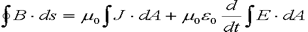
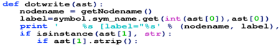
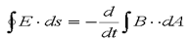
Outline
My Teaching Experience
Other Full-time Teaching Commitments
Student Research Involvement
General Faculty Data
Active Learning

Slide 3
My Teaching Experience How I got started
M.S. in Physics (2005) is minimum qualification for Community College teaching
LACCD (LA, Mission, Pierce)
Cerrito’s College
PhD in Physics (2011), I begin teaching at CSUN – undergrad courses

Slide 4
Teaching Responsibilities In the Classroom
Began teaching Introductory Astronomy Lecture
Adopted department Textbook and sample syllabus
Planned and wrote all lectures
Designed a set of quizzes and exams (modeled from previous professor)
General Physics Lectures
+ Adopted Power-point
Calculus-based Mechanics, Thermodynamics and Electromagnetism
Labs include updating hardware, developing worksheets, and small telescope observations for Astro Lab

Slide 5

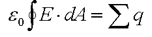

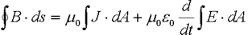
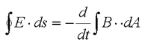
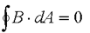
Full-Time Teaching
@
Moorpark College

Slide 6
Ventura County FT Contract Obligations
Aside from Teaching Load (~15 units)
Equivalent to 15 classroom contact hrs
Prof. Dev.: 35 hrs minimum per year
Campus Svc.: 87.5 hrs minimum per semester
Multi-step Tenure Process

Slide 7
Tenure Process Simplified
4 yrs @ CC
6 yrs @ CalState, w/5 yr. eval. for full professor
The process involves multiple classroom visits, and an overview of the candidate’s file
The committee bases its judgments and recommendations on four core principles:
teaching effectiveness
research and publications (Not for CC)
service to the campus and
community and overall collegiality
Teaching effectiveness is determined by
classroom visits from the Tenure Committee
evaluations from students.
Portfolio material

Slide 8
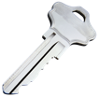
Faculty Campus Involvement from committees to governance
Teacher are part of the campus infrastructure.
There is so much more to being a full-time teacher than only teaching.
Our responsibilities extend outside the classroom in many ways; i.e.,
hiring committees,
professional development,
Mentoring student clubs,
Advising undergrad and graduate projects and thesis dissertations,
faculty senate,
making recommendations to facilities,
applying for grants to enhance student programs and curriculum,
Redesigning curriculum and class materials
Campus service (info tables on week 1),
Student Success Conferences, etc... The list goes on and on.
1) Satisfy your contract, and 2) choose what attracts you the most.
You’ll learn more than you think via Trial & Error
Notes:
More and more faculty are being asked not only to teach, but to also become part of the campus infrastructure.
There is so much more to being a full-time teacher than only teaching.
Our responsibilities extend outside the classroom in many ways; i.

Slide 9
Spring 2018 Weekly Schedule

Slide 10
Student Research
at Jet Propulsion Lab
&
on campus

Slide 11
Student Research— for experience and/or for credit
@JPL
Summer Internships via JPL and/or Caltech SURF, and other
There are also student programs; i.e., APT, APX, CURE, SiRi, and others, that allow student participation during school year.
On campus (Moorpark, CSUN)
Independent Study and/or
Research Units are available to students at all campuses.

Slide 12
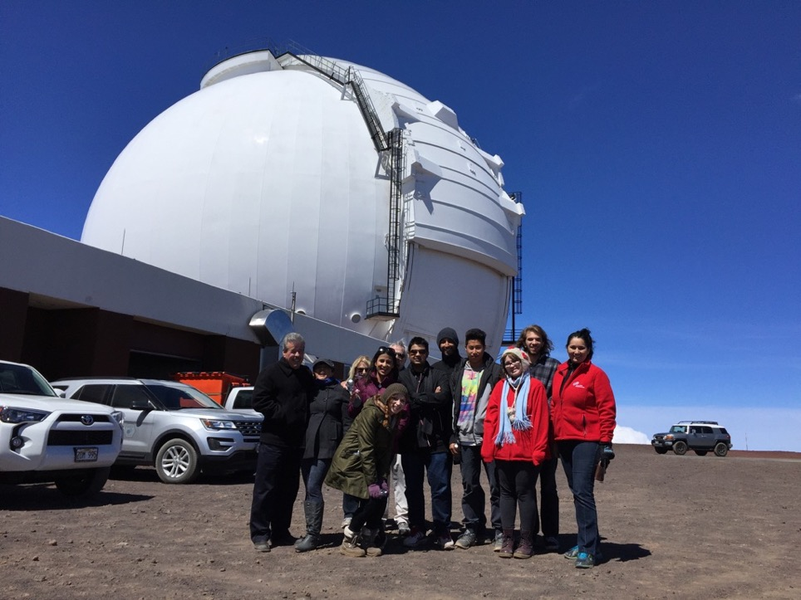
Spring 2016 Planet Hunters from Moorpark College

Slide 13
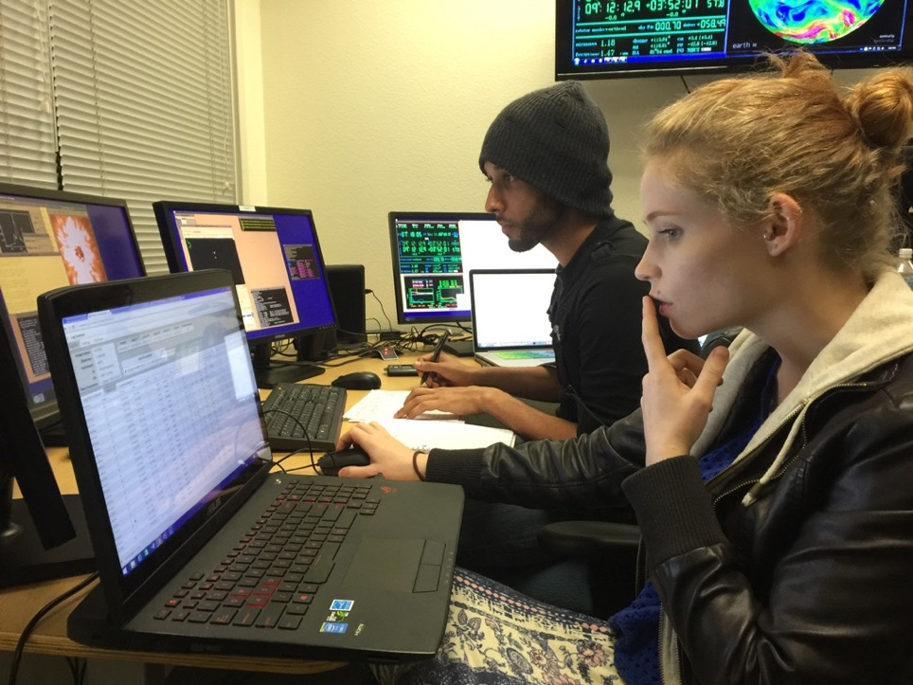
Moorpark—Spring 2016 Interns
@Control Room
Waimea, HI
Spring 2016

Slide 14
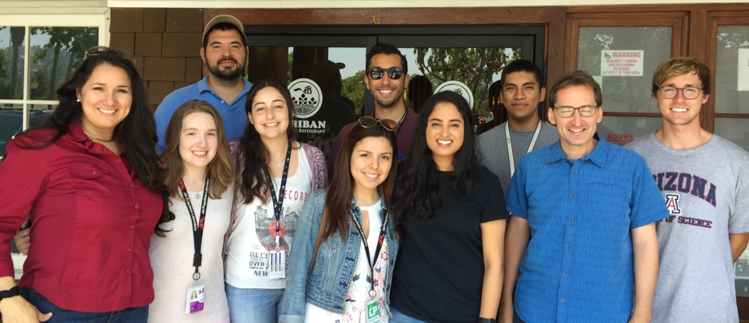
JPL Summer 2017 Interns

Slide 15
National Physics Faculty Stats
From the
America Physical Society (APS) and
AIP Research Center

Slide 16
Physics Doctorates Initial Employment
American Institute of Physics (AIP) Statistical Research Center
2010 Survey of Physics/Astronomy Degree Granting Departments
Employment Sectors
# of Physics/Astronomy Faculty Members per department
Starting Salaries

Slide 17
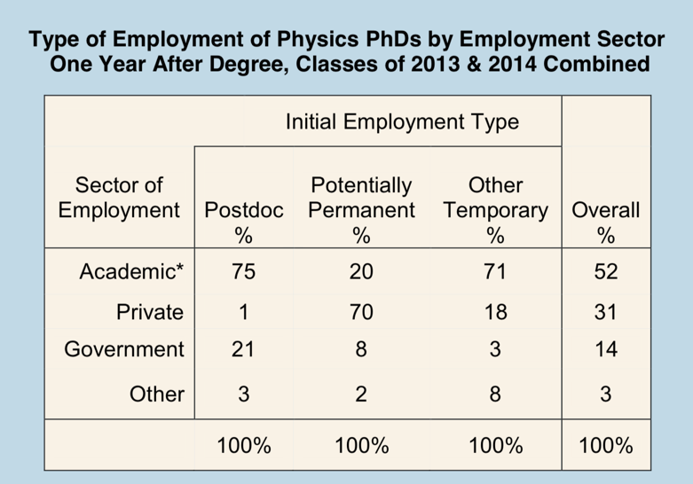
The majority of new PhDs in potentially permanent positions were employed in the private sector.

Slide 18
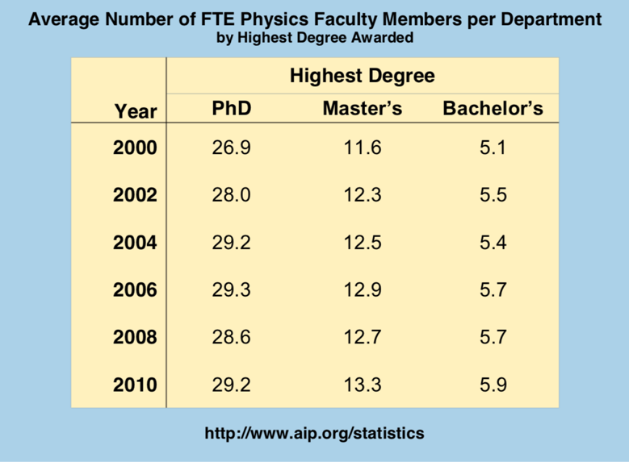
the average # of FTE faculty members in physics depts. that award a doctorate grew at a compounded annual rate of 0.8%

Slide 19
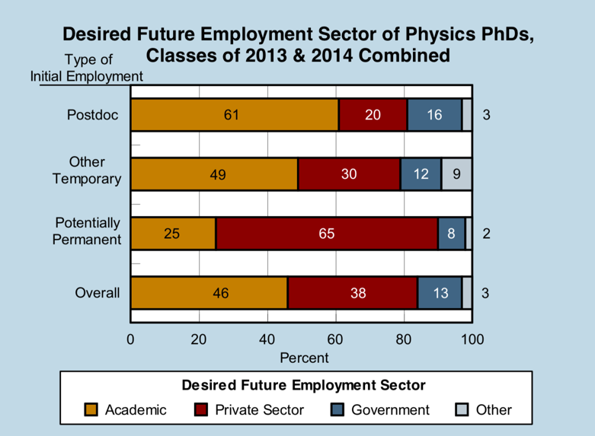
Overall, 46% of new physics PhDs hoped to be employed in academia in 10 years

Slide 20
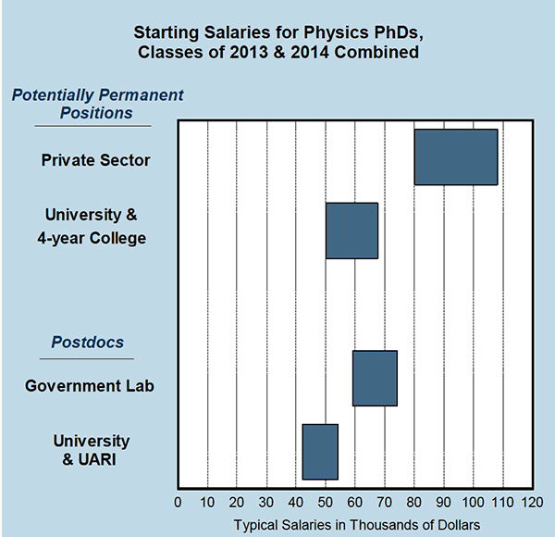
Postdocs at government labs typically had higher starting salaries than postdocs in academia, with medians of $65,500 and $48,000 respectively.
https://www.aps.org/careers/statistics/phdsalary.cfm
UARI is University Affiliated Research Institute

Slide 21
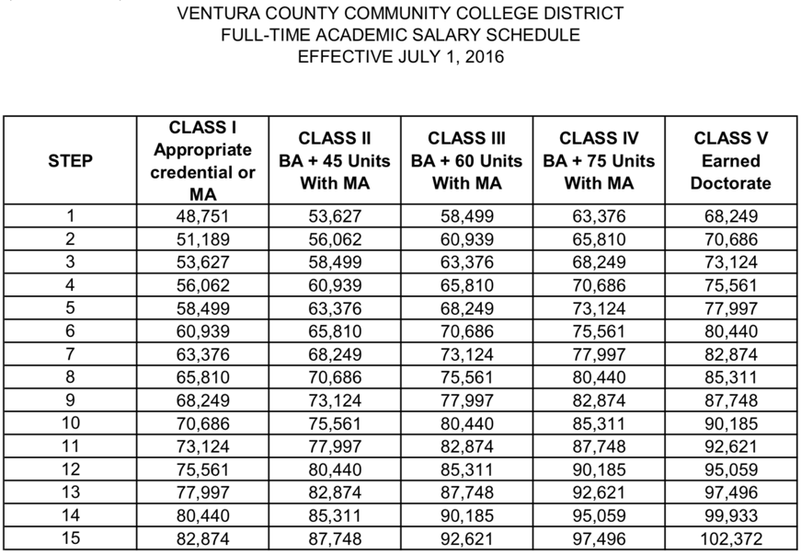
http://www.vcccd.edu/departments/human-resources/salary-schedules

Slide 22
Present Teaching Challenges
Active Learning
Adapt or Die
The “Millennials” are in College

Slide 23
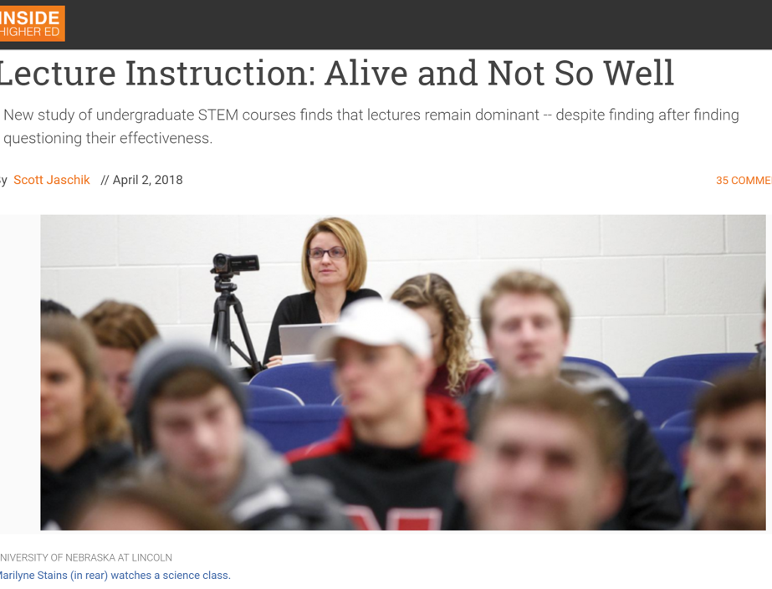

Slide 24
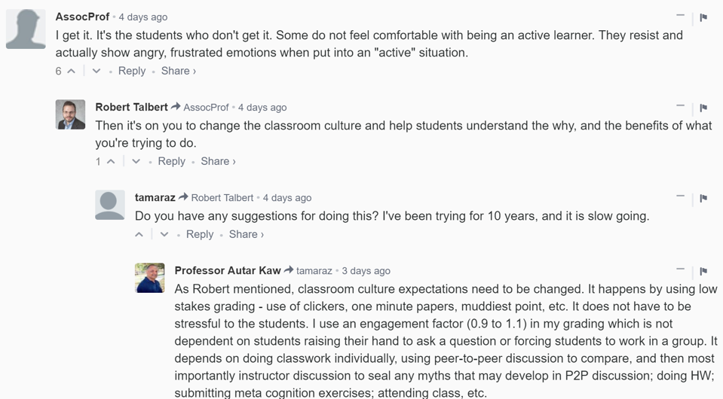
It’s a difficult Problem

Slide 25
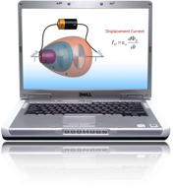


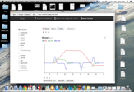
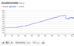
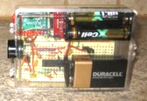
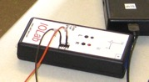
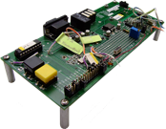
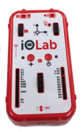
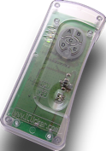
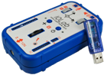
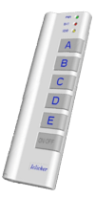
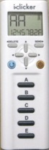
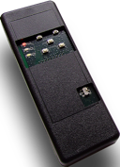
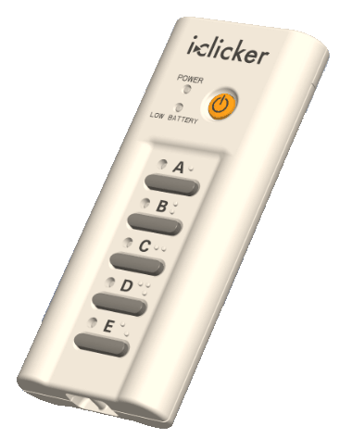
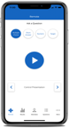

iOLab
2002
2006
2010
2014
2018

Slide 26
Enable a Paradigm shift from this…
Homework
& exams
Lab
Lab
Homework
& exams
Lecture
Lecture
Discussion
Discussion
Professor View
Student View

Slide 27

… toward this

Slide 28
For Example: Intro Physics at Illinois (Spring 2018)
Calculus Based: # Students
Mechanics (Phys 211) 1202
E&M (Phys 212) 734
Stat. Mech. (Phys 213) 720
Quantum (Phys 214) 695
Algebra Based:
Mechanics, Heat (Phys 101) 357
E&M, Modern (Phys 102) 352

Slide 29
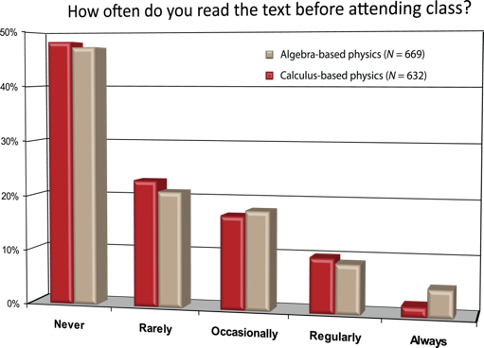

Big Challenge (2008)
Students not reading text & not prepared to learn
Have to assume that students in class know nothing
Spend valuable class time just getting them started
Notes:
Have to assume that students in class know nothing
Spend valuable class time just getting them started

Slide 30
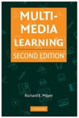
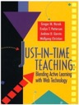
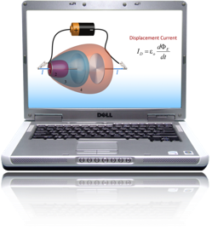
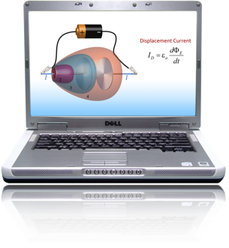
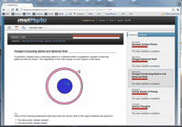


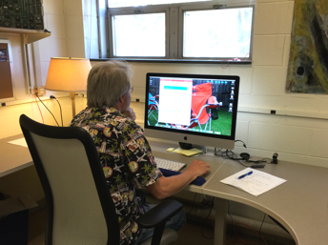


Pre-Lecture (before class)
JiTT Questions (before class)
Monday Night
Tuesday Morning
Active Classroom
Professor prepares for class
ask 8-12 clicker questions per lecture

Slide 31
The result was astonishing:
Before (1995)
After (2001)
Before (Spring 95)
Total Physics TAs = 77
# “Excellent” = 15
19 ± 5 %
After (Spring 01)
Total Physics TAs = 75
# “Excellent” = 58
77 ± 6 %

Slide 32
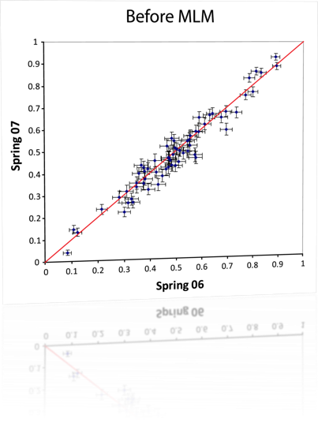
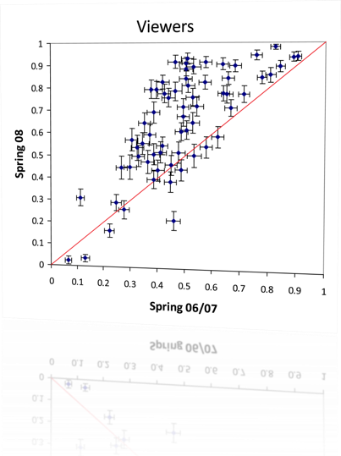
Checkpoint Study Scores
Before
After

Slide 33
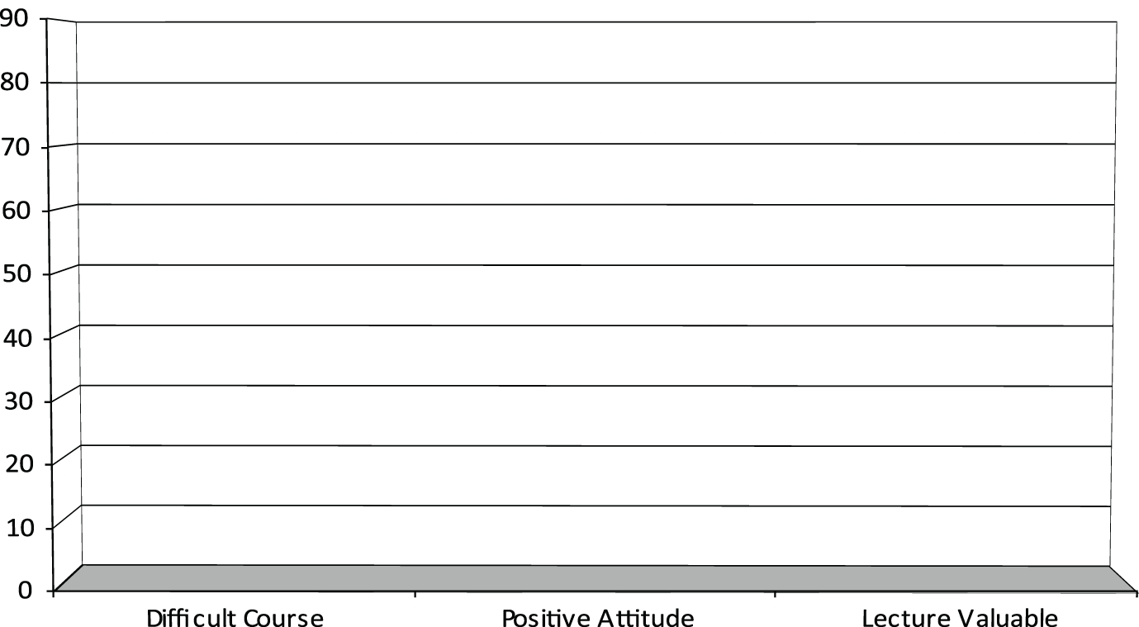
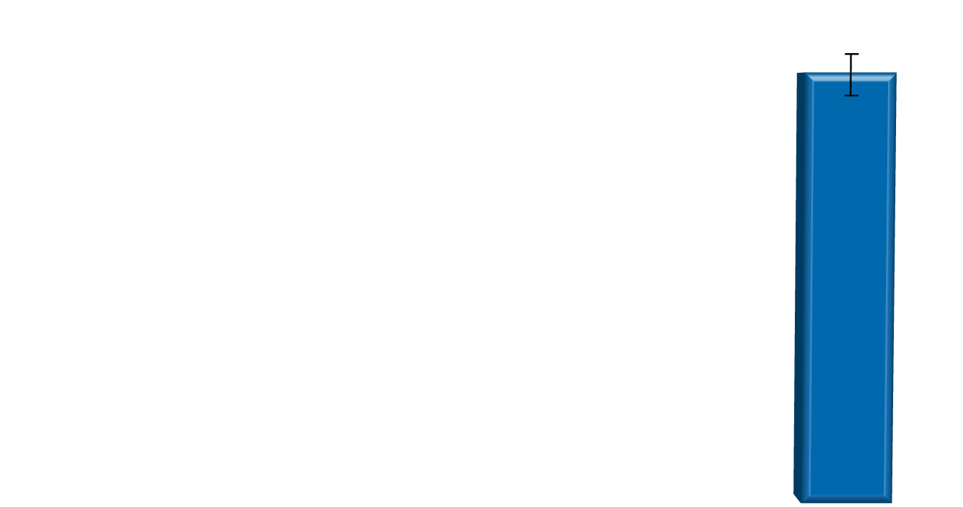
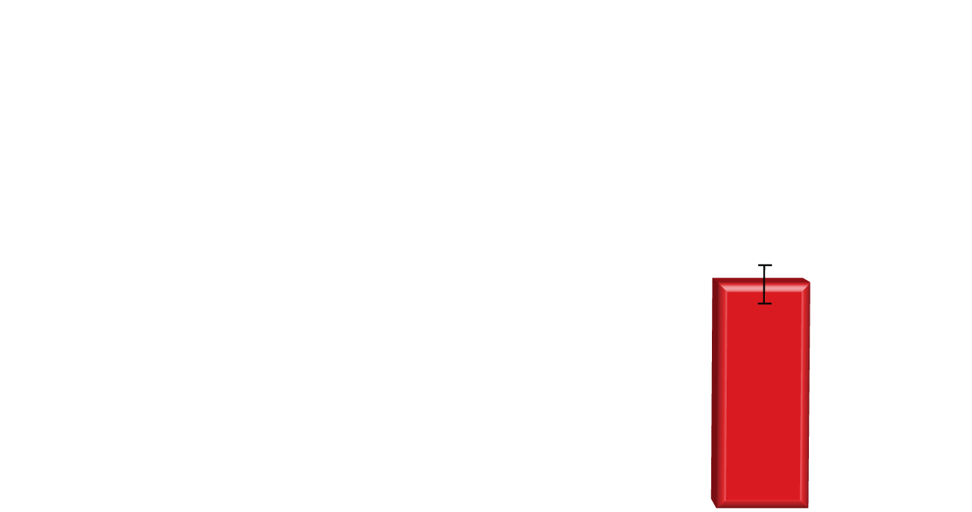
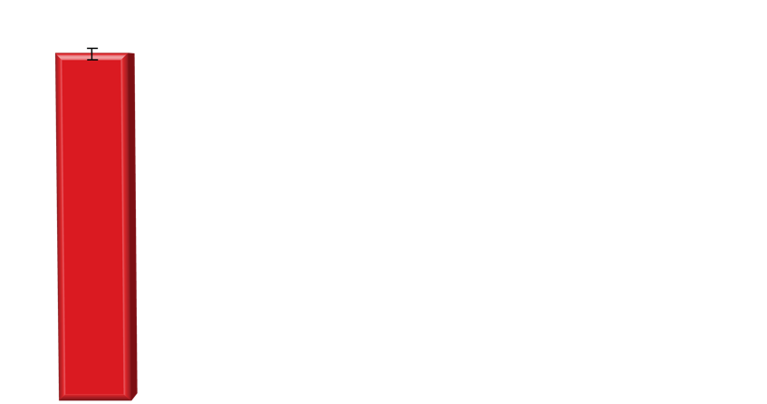
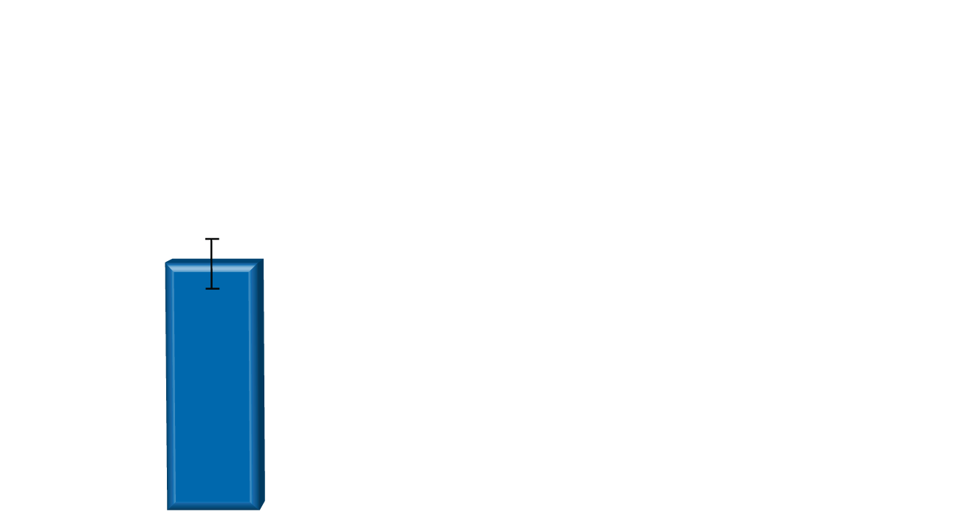
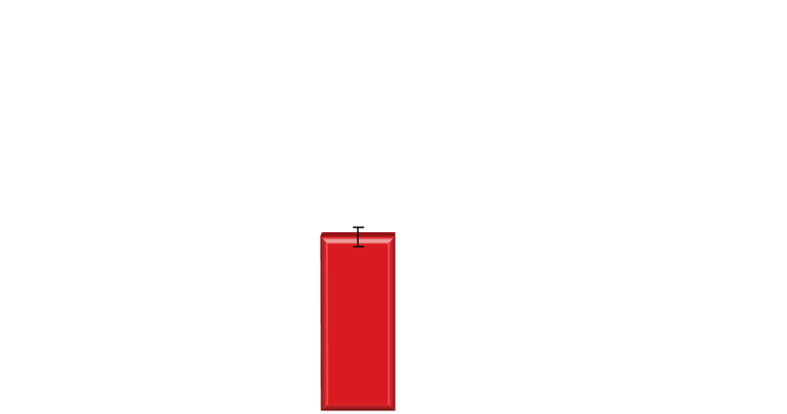
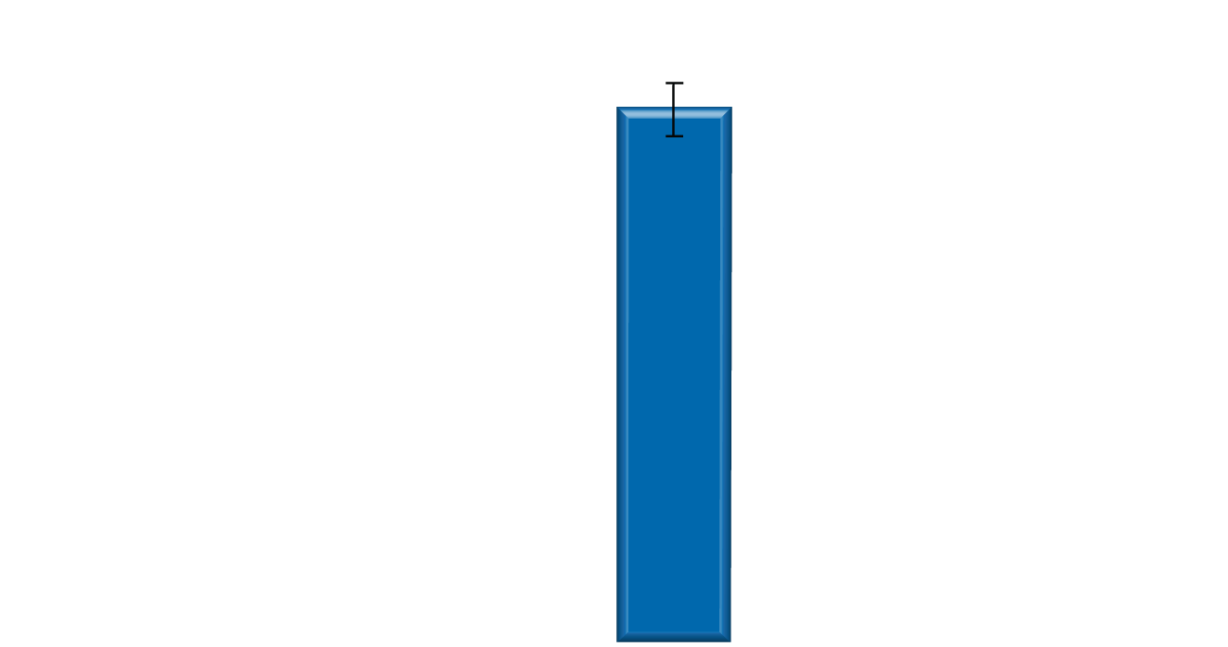
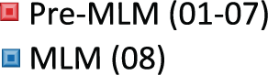
Student Perception of Physics Course
Before
After

Slide 34
The “Millennials” are in College
Use Technology to Enhance Good Teaching, Not Replace Good Teaching
PowerPoint, course management systems, i.e. CANVAS, student response systems (“clickers”), podcasting, and online learning systems.
Develop Collaborative Course Assignments
Wikis invite participation without needing to bring people together in the same place
Research Units are available to students at all campuses.
Adopt Smart Classroom (i.e. big screen, etc.)
But get out from behind the lectern and become front and center in the learning process

Slide 35
Thank You!

Slide 36
Our Workshop includes trying out a tool for active learning Design a set of questions to query your “class” to asses learning

